Slide 1
Agentic AI Hackathon: Building Intelligent Agents with IBM Granite and LangFlow

Slide 2

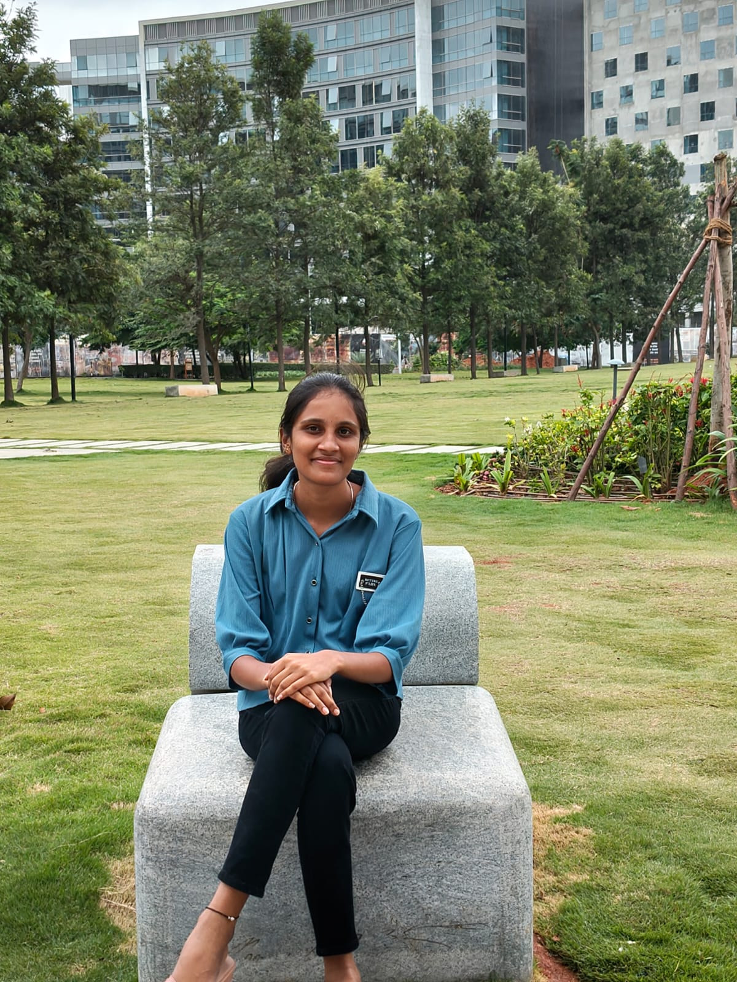
Name of the team: SKYMINDS
Details of Team members
TEAM MEMBER NAME | Recent Passport Photo | Email ID | Phone number [WhatsApp]
Vijaya Nikilesh YM |  | vijayanikilesh@gmail.com | 8660467851
Talanki Varshini |  | Varshini@kssem.edu.in | 8106989509

Slide 3
Problem statement
Intelligent AI System for Pest and Disease Risk Assessment
Agriculture productivity is heavily affected by pests and crop diseases, which are influenced by environmental conditions, soil characteristics, and seasonal changes. Farmers often lack intelligent tools to assess pest and disease risk at an early stage. Traditional methods rely on manual inspection and generic advisories, which are often late, inaccurate, or not location-specific. There is a need for an AI-driven system that can analyze crop, soil, climate, and environmental data to assess pest and disease risk and provide early, actionable guidance to farmers.

Slide 4
Proposed solution
We propose an AI-based system that helps farmers identify pest and disease risk at an early stage. The system uses Agentic AI built with LangFlow and IBM watsonx.ai, where multiple AI agents work together like agricultural experts. Farmers provide information such as crop type, soil condition, climate, and location. The system analyzes soil and environmental conditions to assess pest and disease risk and predicts the risk level as low, medium, or high. It also identifies possible pests or diseases that may affect the crop. Finally, the system provides simple, farmer-friendly advice to reduce crop loss and improve agricultural yield.

Slide 5
Need of project
Farmers are unable to effectively interpret complex environmental factors such as temperature, humidity, rainfall, soil type, and seasonal patterns to assess pest and disease risk. Existing agricultural advisory systems mainly provide generic recommendations without considering crop-specific, soil-specific, and climate-aware risk assessment. There is no integrated system that predicts pest and disease risk early and converts it into simple, farmer-friendly advisory. Hence, there is a strong need for an intelligent, explainable, and agent-based AI system that supports early risk detection and preventive decision-making in agriculture.

Slide 6
End user of project
Farmers
Agricultural Extension Officers
Rural Advisory Centers
Agri-tech platforms
Government agriculture departments

Slide 7
Technology Used
Langflow platform
Langflow component name – Agent , Chat input , Chat output
IBM Grainte model - for eg – ibm-granite-3-2-8b
IBM Cloud
RAG if used
IBM Watsonx.ai
Watsonx

Slide 8
Novelty and Uniqueness
Uses a multi-agent GenAI architecture instead of a single prompt-based system
Integrates crop, soil, climate, and risk analysis for pest and disease assessment
Provides early risk prediction rather than post-damage diagnosis
Produces explainable and farmer-friendly outputs
Modular agent design allows easy scalability across crops and regions

Slide 9
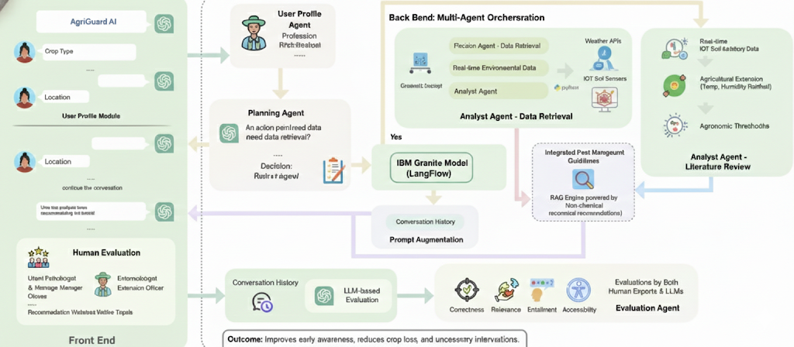
Technical flow diagram - Architecture blueprint

Slide 10
Langflow component Used
1) Chat Input
This component serves as the entry point for the system. It captures farmer-provided information such as crop type, soil condition, environmental factors, and location details, which are passed to the agent pipeline for analysis.
2) IBM watsonx.ai Agent
Multiple agent components act as agricultural domain experts. Each agent uses IBM Granite foundation models through watsonx.ai and follows specific agent instructions to perform tasks such as context understanding, risk assessment, disease identification, and advisory generation.
3) Chat Output
This component displays the final farmer-friendly advisory, including pest and disease risk level, possible issues, and recommended actions.
4) Other Components Used
Agent Instructions – Define the role and behavior of each agent
Language Model (IBM watsonx.ai) – Provides reasoning and expert knowledge
Sequential Agent Flow – Ensures step-by-step decision making

Slide 11
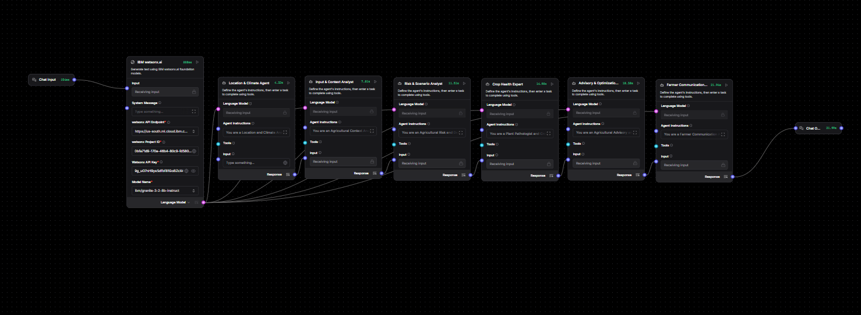
Input Screenshot 1

Slide 12
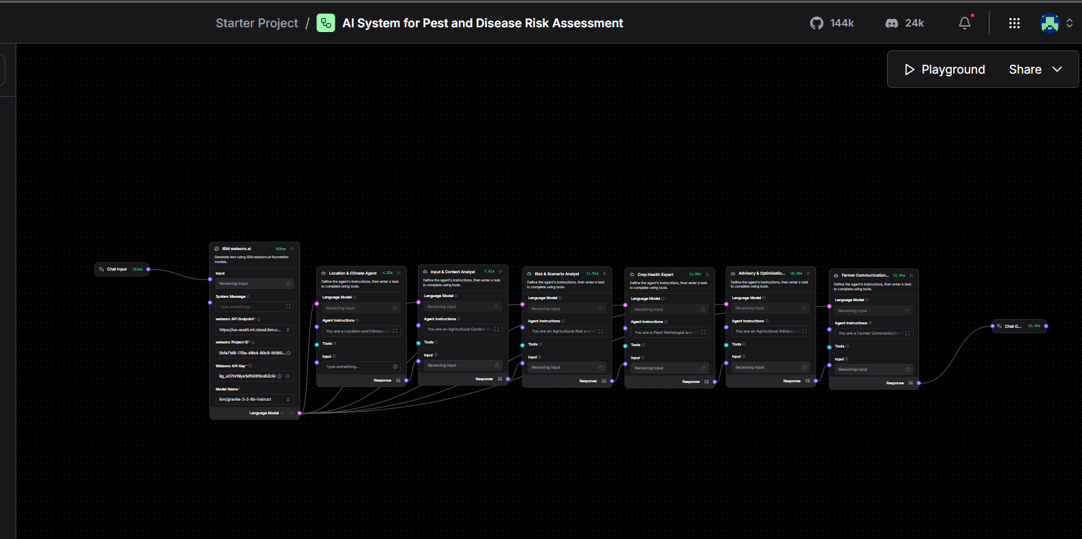
Input Screenshot 2

Slide 13
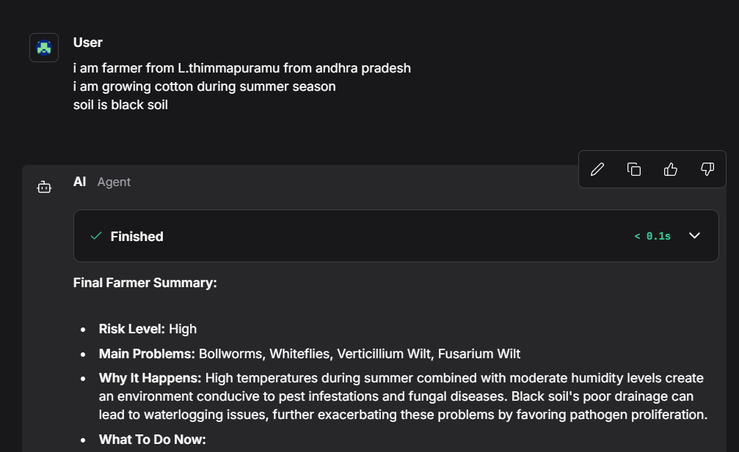
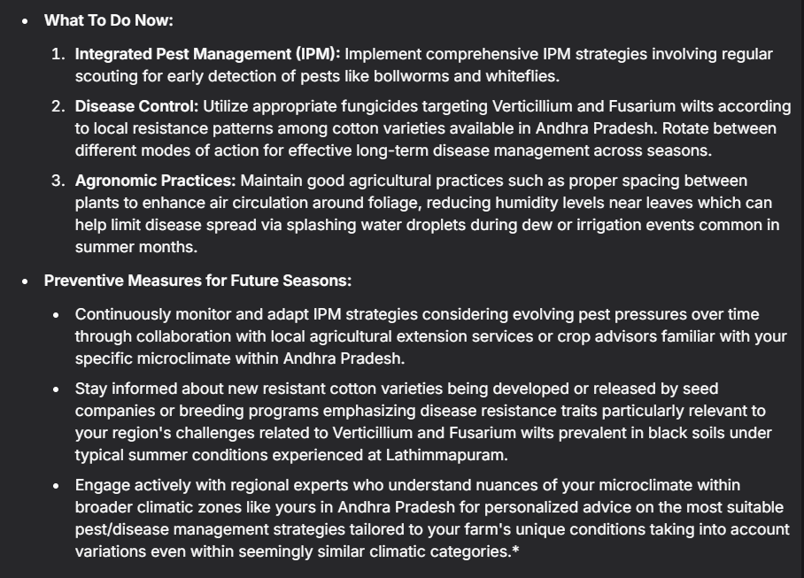
Output Screenshot 1

Slide 14
Future Scope
The system can be further enhanced by integrating real-time weather and climate APIs to provide more accurate pest and disease risk predictions. The use of IoT sensors can enable live monitoring of soil moisture, temperature, and humidity for better decision-making. The solution can be expanded to support multiple crops and regions with region-specific pest and disease knowledge. Regional language support and voice-based interaction can improve accessibility for farmers. A mobile application can be developed to allow easy access for farmers in rural areas. The system can also be integrated with government agricultural guidelines and policies to ensure safe and compliant advisory.
·
·
·

Slide 15
Git Hub Link
· Please create public github repository (Enable Add README button while creating repository) with format –
Please test and Paste the working Github URL – https://github.com/vijayx2521/ibm-hackathonvs.git
Make sure you have Uploaded following three files into your github repository
1) app.py file , 2) your_hackthon_problemstatement.pdf file 3) your projectpresntation.pptx file
·
·
·

Slide 16
References
IBM watsonx.ai Documentation
https://www.ibm.com/docs/en/watsonx
IBM Granite Foundation Models
https://www.ibm.com/granite
LangFlow Official Documentation
https://docs.langflow.org
·
·
·
·

Slide 17


